Slide 1
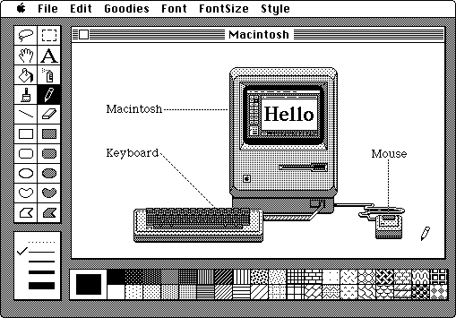
The Reader as User
A Samuel Pottinger
Stat 198: IDSV
Mar 19, 2025

Slide 2
Why formalize the role of the user?
Today I want to identify different ways of thinking about the role of the user as lenses that you can use to understand your design.
Seeing your visualizations from multiple perspectives can help your pieces be more successful.

Slide 3
Today
> Audiences: interrogating our lenses.
Group activity: examine an interactive data visualization.
Waves of HCI: affordances and ergonomics, dialogue, context.
Something else: games and media for thought.

Slide 4
Audiences
Visualization
Author
Audience

Slide 5
Audiences
Assumptions, Focus, Language
Author
Audience

Slide 6

Audiences
Dominant, Oppositional, Negotiated
Author
Audience
Stuart Hall: Reception Theory

Slide 7
Today
Audiences: interrogating our lenses.
> Group activity: examine an interactive data visualization.
Waves of HCI: affordances and ergonomics, dialogue, context.
Something else: games and media for thought.

Slide 8

Review a data visualization
https://www.theguardian.com/us-news/2022/mar/13/how-covid-shook-the-us-charts-graphs
Dominant reading
Oppositional reading
Negotiated reading

Slide 9
Today
Audiences: interrogating our lenses.
Group activity: examine an interactive data visualization.
> Waves of HCI: affordances and ergonomics, dialogue, context.
Something else: games and media for thought.

Slide 10
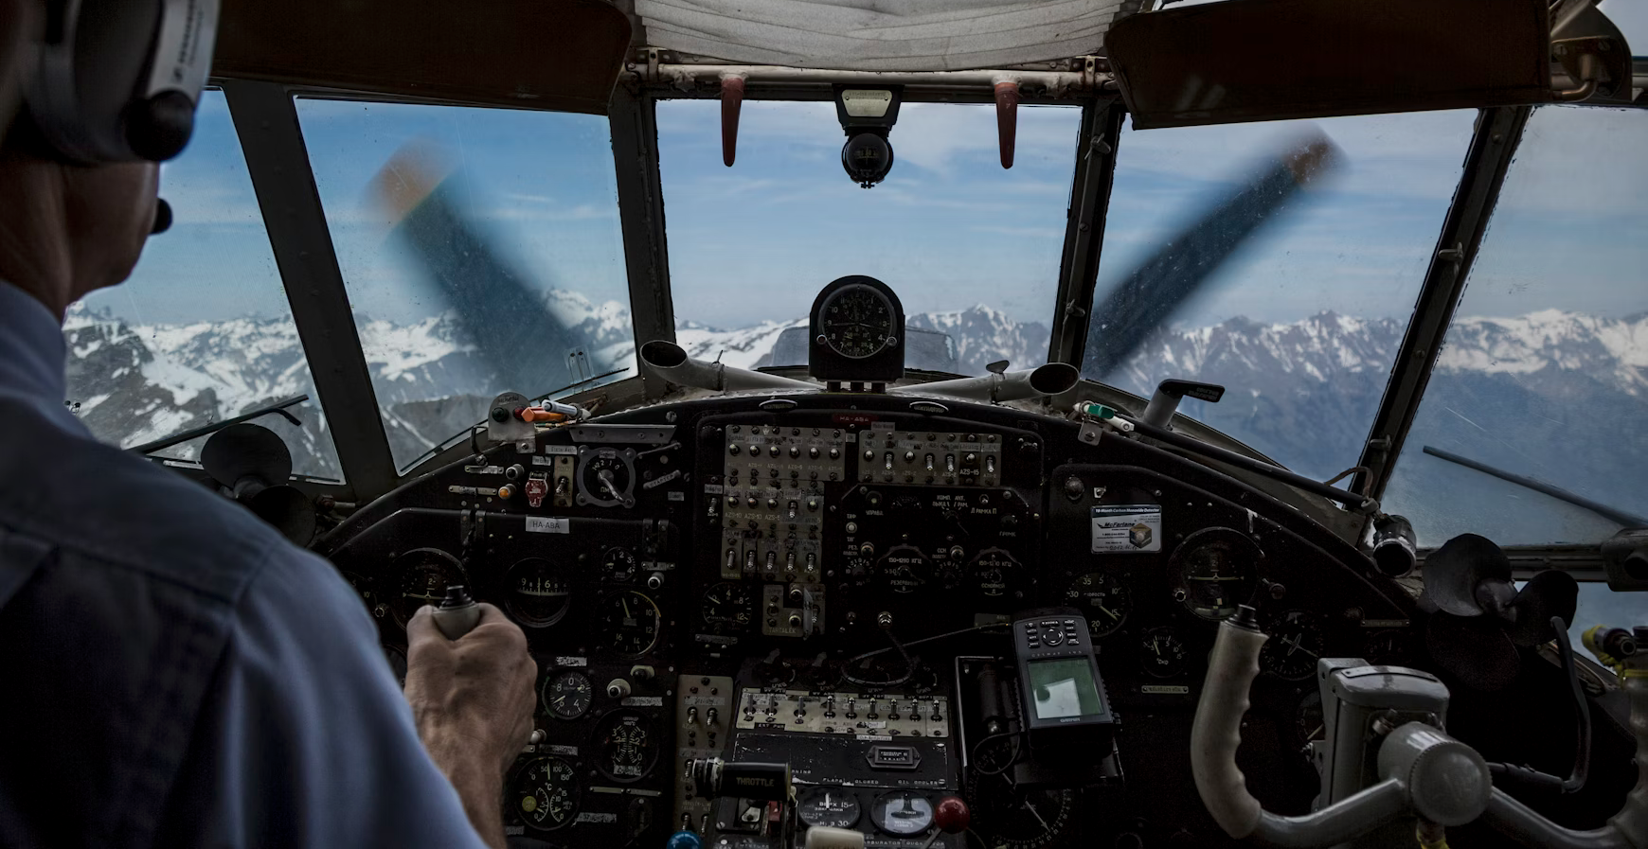
What is the user?
Wave 1
Ergonomics
Wave 2
Information
Wave 3
Context

Slide 11



What is the user?
Wave 1
Ergonomics
Wave 2
Information
Wave 3
Context

Slide 12
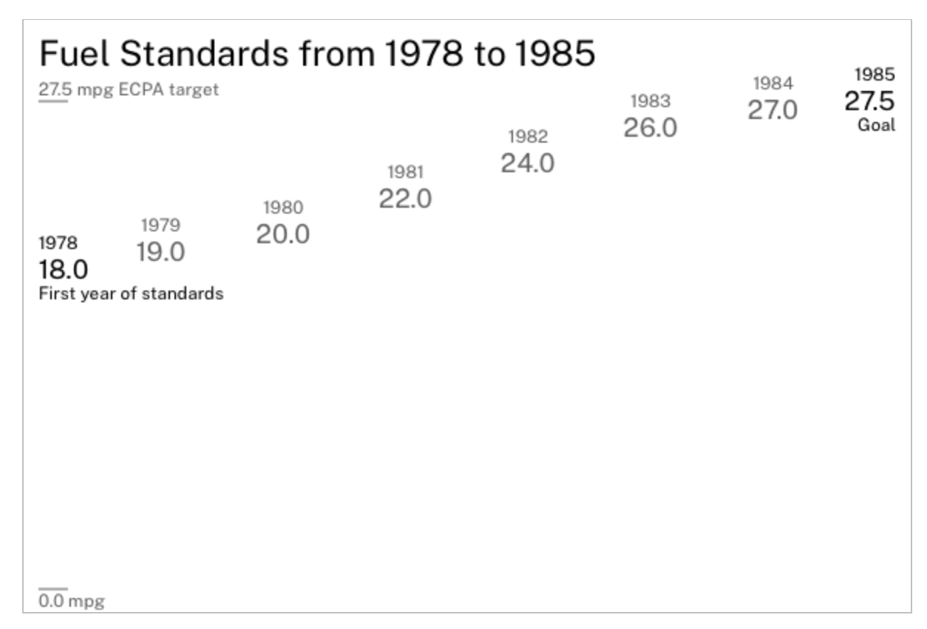
What is the user?
Wave 1
Ergonomics
Wave 2
Information
Wave 3
Context

Slide 13
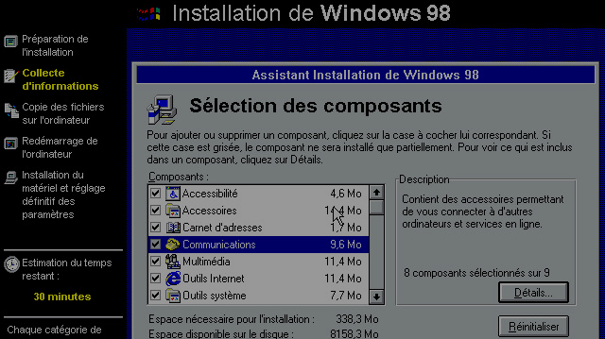
What is the user?
Wave 1
Ergonomics
Wave 2
Information
Wave 3
Context

Slide 14
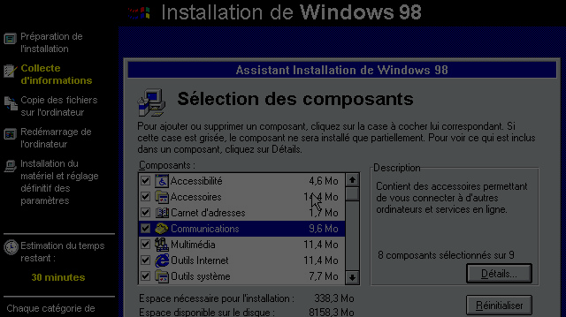
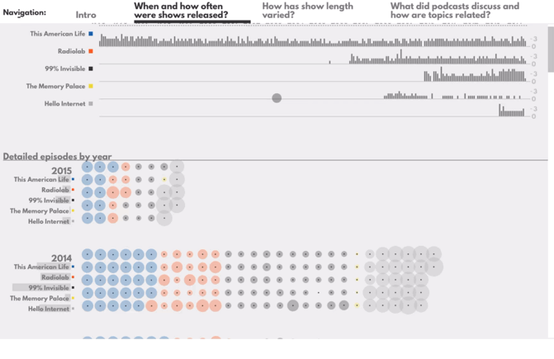
What is the user?
Wave 1
Ergonomics
Wave 2
Information
Wave 3
Context

Slide 15
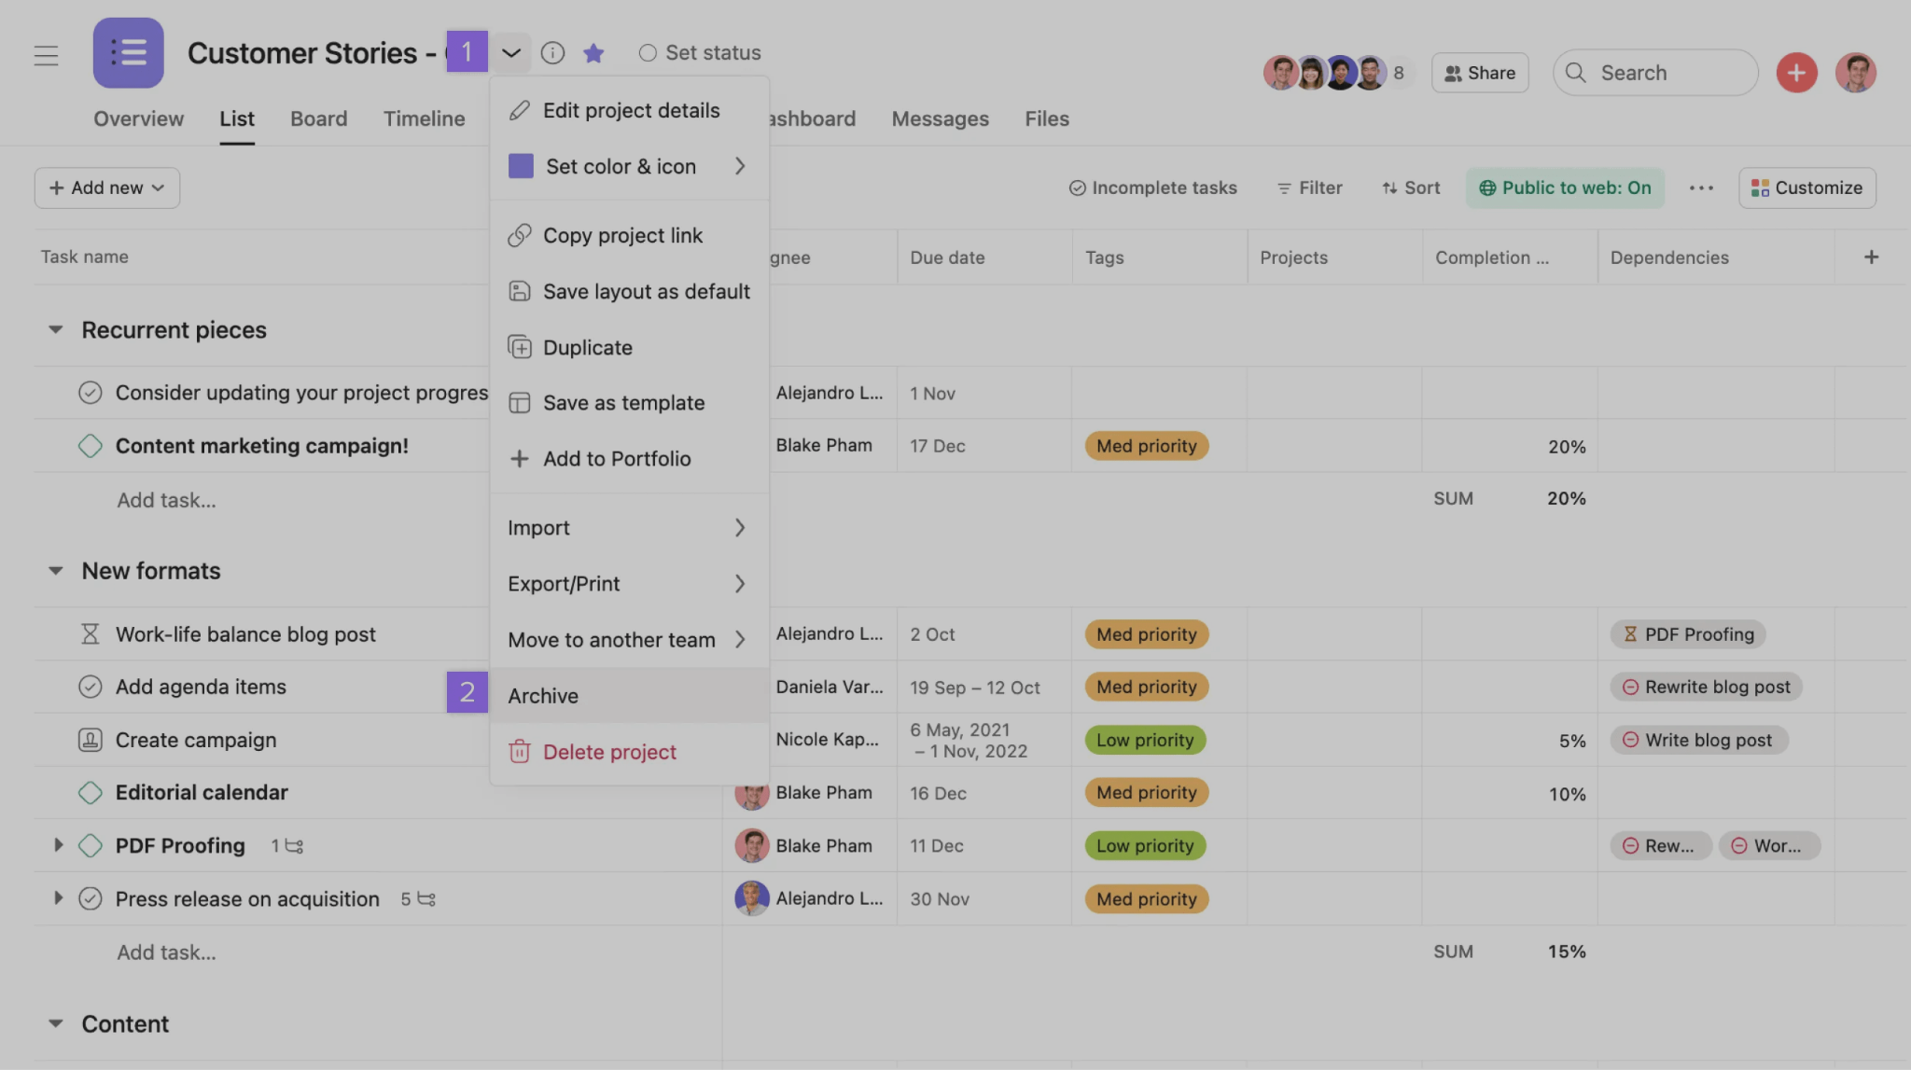
What is the user?
Wave 1
Ergonomics
Wave 2
Information
Wave 3
Context

Slide 16
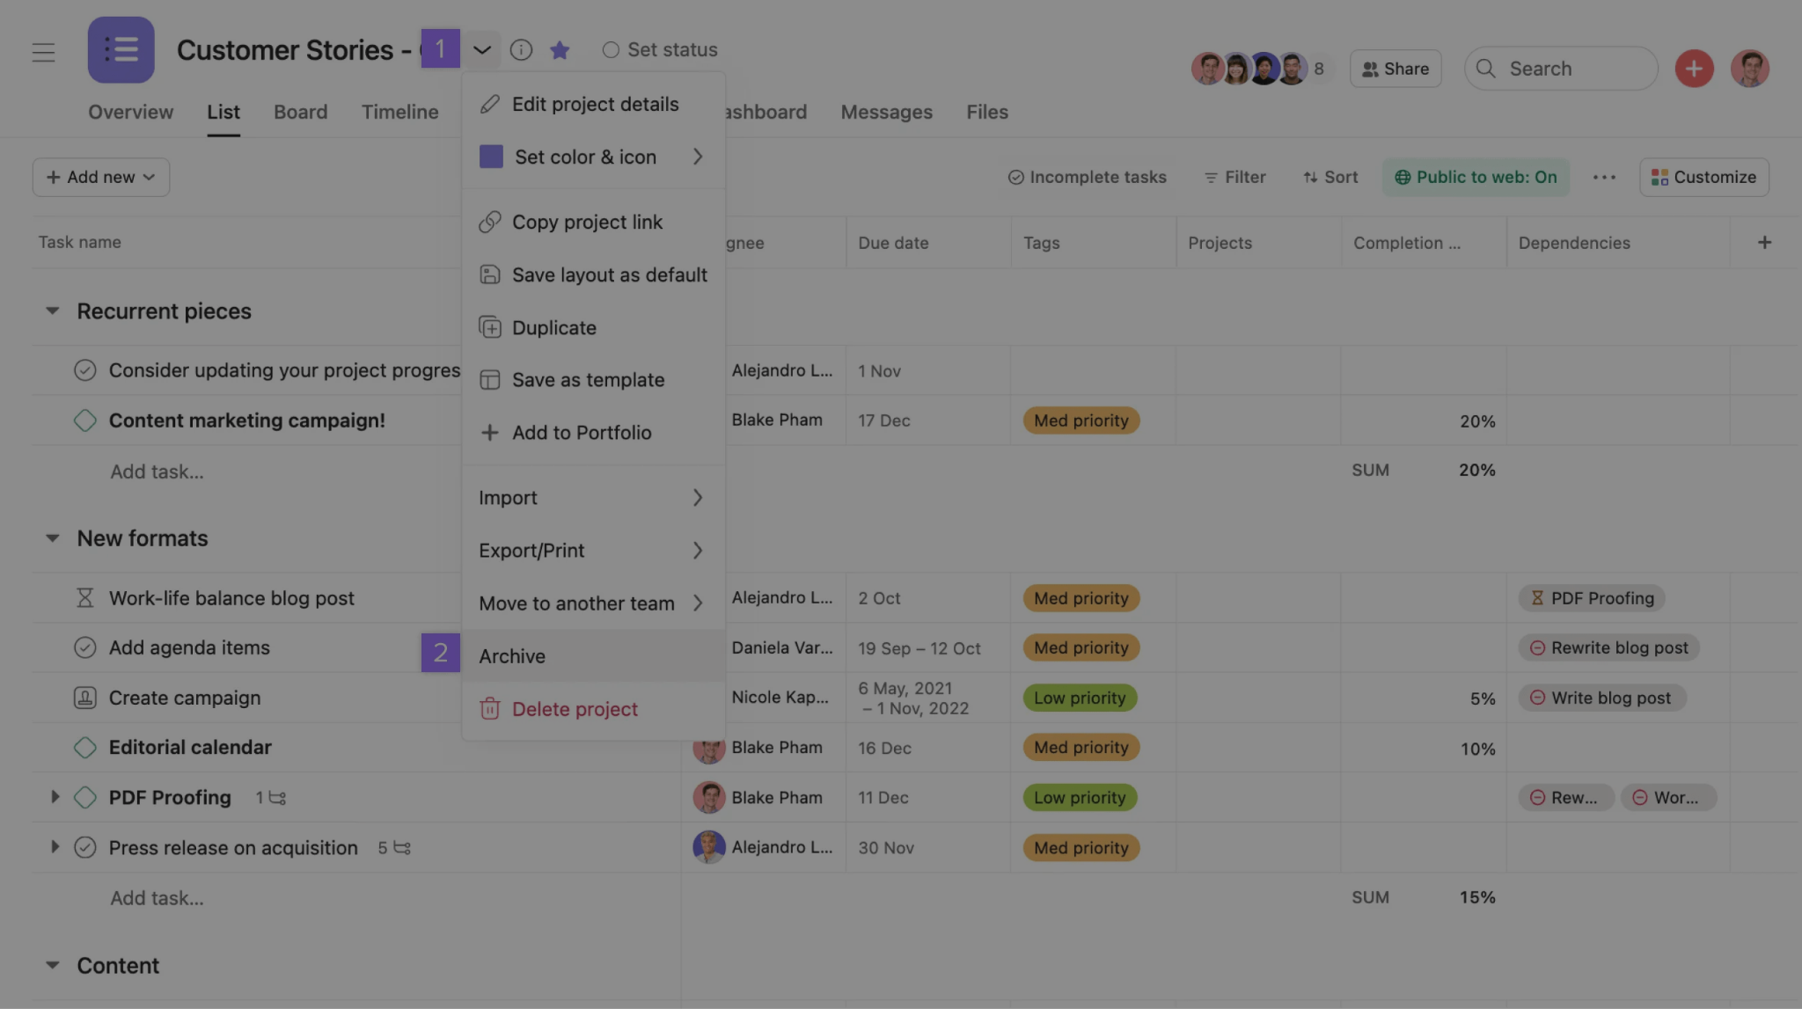
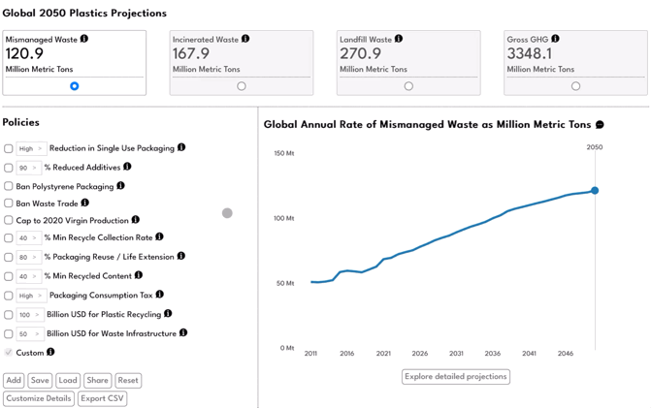
What is the user?
Wave 1
Ergonomics
Wave 2
Information
Wave 3
Context

Slide 17
Today
Audiences: interrogating our lenses.
Group activity: examine an interactive data visualization.
Waves of HCI: affordances and ergonomics, dialogue, context.
> Something else: games and media for thought.

Slide 18
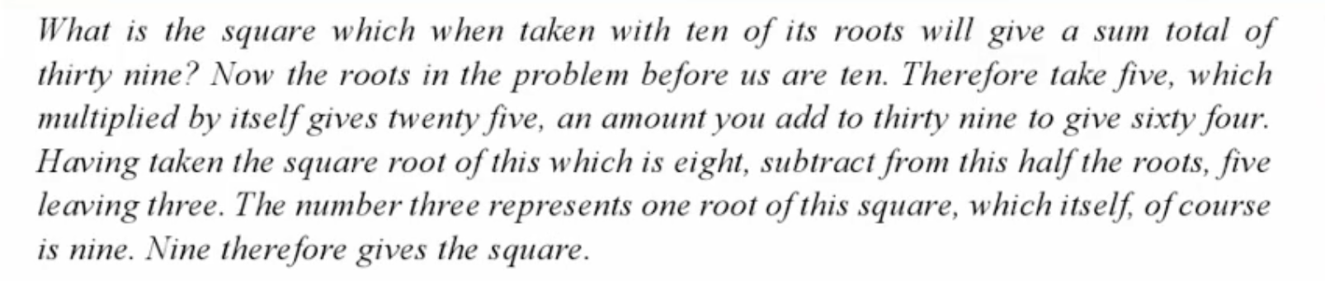
Media for thought

Slide 19
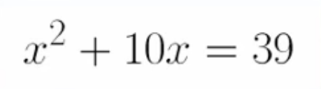
Media for thought

Slide 20
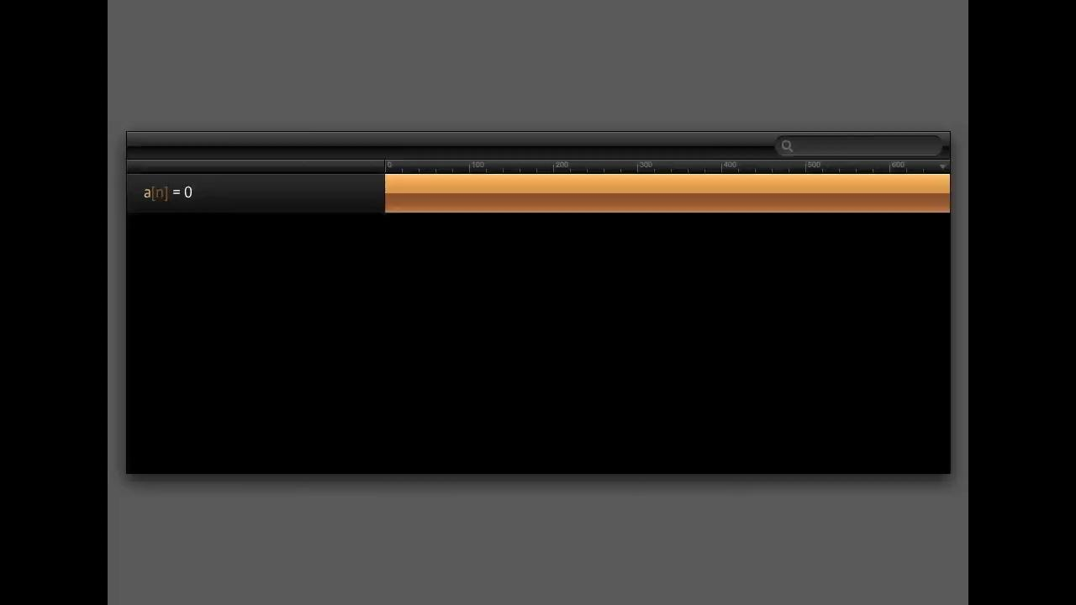
Media for thought

Slide 21

Games
Games as a co-created experience between the player and piece of technology / designer.

Slide 22

Games

Slide 23
Recap
What is the user within data visualization?
A robot which interprets through a mechanical system.
A conversation with a series of questions for which a series of learnings complete a task.
An entity with thought interpreting the work through a series of personal and cultural lenses within a social system.
A co-creator of meaning, using the work as a way to think new thoughts and create sometimes uniquely individual experiences.

Slide 24
Recap
What does this mean?
Make it clear how a data visualization should be used and fine tune the mechanisms through which a person “mechanically” interacts.
Think about the flow of a user (user loops) and how we support a series of questions or tasks.
Critically interrogate the context of this visualization and how it may interact with the graphic.
Create spaces that can be activated by the user to see, feel, do, and think new things.

Slide 25
Citations
M. Hoekstra, “MacPaint,” Geek Technique, 2007. Available: https://www.geektechnique.org/blog/786/mac-paint.html
"Reception Theory," Revision World. Available: https://revisionworld.com/a2-level-level-revision/media-studies-level-revision/reception-theory#google_vignette
J. Tong, "Diagrammatic thinking and audience reading of COVID-19 data visualisations: A UK case study," Convergence, 2024. doi: 10.1177/13548565241309886.
"Stuart Hall," Wikimedia Foundation, 2025. Available: https://en.wikipedia.org/wiki/Stuart_Hall_(cultural_theorist)
E. Berger and A. Witherspoon, "How Covid shook the US: eight charts that capture the last two years," The Guardian, 2022. Available: https://www.theguardian.com/us-news/2022/mar/13/how-covid-shook-the-us-charts-graphs
S. Harrison, P. Sengers, and D. Tatar, "The Three Paradigms of HCI," CHI 2007, 2007.
"Understanding Projects," Asana. Available: https://help.asana.com/s/article/understanding-projects?language=en_US
Schell, Jesse. The Art of Game Design: A Book of Lenses. CRC Press, Taylor & Francis Group, 2020.
Wright, Will. “Spore, Birth of a Game.” TED, Ted Conferences, 2007, https://www.ted.com/talks/will_wright_spore_birth_of_a_game.
S. Dale. "Back wooden 4-Panel Door Closed," Unsplash, 2018. Available: https://unsplash.com/photos/black-wooden-4-panel-door-closed-dJycgkec2p0
L. Parren, "Pilot Driving Plane During Daytime," Unsplash, 2018. Available: https://unsplash.com/photos/pilot-driving-plane-during-daytime-S3xxiedz0hE
F Bezies, "Installation MS-Windows 98," Flickr, 2013. Available: https://www.flickr.com/photos/fredbezies/9136730422/

Slide 26


